Slide 1
CSCI 1301 Introduction to Computing and Programming
Spring 2015

Slide 2
Announcements
Project 4 due April 3rd
Lab 8 due March 20th, 9PM
This week: Cover sections 5.1 – 5.3
Read chapter 5. Read it twice.
Withdrawal Date: March 19th
Exam 2: TBA
Review for Exam 2: TBA
ICPC Practice: Wednesdays 5-6 in BOYD 306
Google is coming!

Slide 3
Basics of Classes, Objects, and Methods
Chapter 5

Slide 4
Java Object-Oriented Programming
Java is an object-oriented programming language.
A program can be viewed as a collection of interacting objects.
Some objects might represent physical entities (automobiles); others might have no counterpart in the real world (Scanner).
Each object has a set of characteristics (attributes/data).
An object representing a student might have: first name, last name, 810-number, email-address, course-load.
The attribute values define the object’s state.
Each object has a set of actions it can perform (its behaviors).
Examples: add a course, drop a course.

Slide 5
Classes
An object in OOP is defined by a class.
Variables are used to define attributes.
Methods in the class define the objects behaviors.
A class is the blueprint/template for creating objects.
Every object belongs to a class.
Once the class is defined, multiple objects (instances of the class) can be created from it.
Essentially, we are creating our own data types!

Slide 6
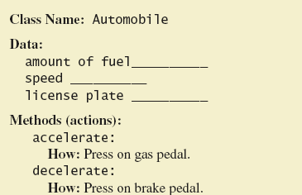
Class and Method Definitions
A class as a blueprint

Slide 7
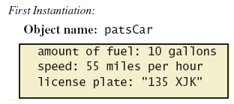
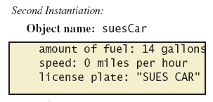
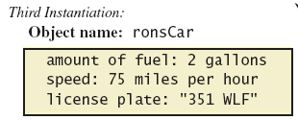
Class and Method Definitions
Objects that are instances of the class Automobile

Slide 8
Classes
To date, we haven’t used many of the object-oriented features in Java.
We have instantiated (created) objects from pre-defined classes
String, Scanner, Grid.
We have created “instances” of these classes.
But we haven’t defined our own classes yet.

Slide 9
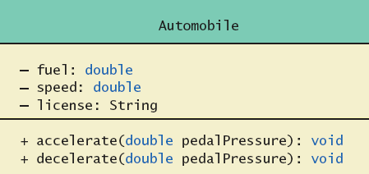
Class and Method Definitions
A class diagram of UML (Universal Modeling Language) is often used to represent classes.
Class Name
Data (Variables)
Methods
‘-’ means the member is “private”; ‘+’ means the member is “public”

Slide 10
Another Example
Student 1
first-name: "Mary"
last-name: "Feeney"
email: "mfeeny@shotz.edu"
…
Student 2
first-name: "Martin"
last-name: "Kosnowski"
email: "mk@shotz.edu"
…
Every object of the same class has the same attributes…
…but likely different values for the attributes.
The class (e.g. Student) defines a blueprint/schema for the objects in it.

Slide 11
Classes in Java
Java is an object oriented programming language.
A Java class definition might look something like this:
Class name
public class Student {
public String firstName;
public String lastName;
public String email;
public void addCourse(Course aCourse){
{
// (This is a comment);
// More code should go here.
}
public void printSchedule(){
{
// Again More code should go here.
}
// Etc. More code could go here.
}
Variables defining
attributes of the class
Class
body
Methods defining behaviors of the class. The first method takes an argument, which it uses to do its stuff.

Slide 12
Class Files and Programs
Every program we have created has consisted of a single Java class definition.
The source file ends in .java.
A program might consist of many such definitions.
The source files are compiled into .class files.
Classes can be compiled separately.
Existing class files can be used in new programs.
Files of the same program are typically bundled together in a common directory.
For instance, c:\csci1301\project4

Slide 13
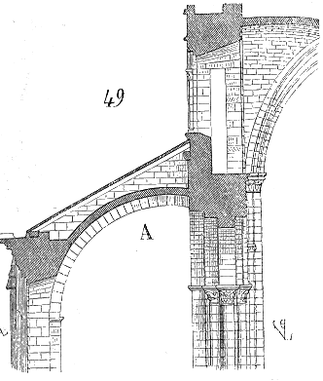
Why Bother?
As program size increases, it’s more difficult to maintain and keep free of errors.
We can’t effectively write everything in a single main method.
Alan Kay: Small programs are like dog houses, big ones are like cathedrals.
Object Oriented programming (OOP) adds structure to a program.
It promotes modularity, extensibility, reusability, maintainability.

Slide 14
public class Dog
{
public String name; // These 3 are instance variables.
public String breed; // Every instance of Dog will have values for them.
public int age; // The values will vary from instance to instance.
public void writeOutput()
{
System.out.println("Name: " + name);
System.out.println("Breed: " + breed);
System.out.println("Age in calendar years: " + age);
System.out.println("Age in human years: " + getAgeInHumanYears());
System.out.println();
}
public int getAgeInHumanYears()
{
int humanYears = 0;
if (age <= 2)
{
humanYears = age * 11;
}
else
{
humanYears = 22 + ((age-2) * 5);
}
return humanYears;
}}
The access modifier public means that other classes can access the variables and methods.
Using public is bad form; it exposes too much of the class.

Slide 15
Using a Class and Its Methods
public class DogDemo
{
public static void main(String[] args)
{
Dog balto = new Dog();
balto.name = "Balto";
balto.age = 8;
balto.breed = "Siberian Husky";
balto.writeOutput();
Dog scooby = new Dog();
scooby.name = "Scooby";
scooby.age = 42;
Scooby.breed = "Great Dane";
System.out.println(scooby.name + " is a " + scooby.breed + ".");
System.out.print("He is " + scooby.age + " years old, or ");
int humanYears = scooby.getAgeInHumanYears();
System.out.println(humanYears + " in human years.");
}
}
Once the class (Dog) is defined, we can create instances of it.
As many as we need
This is called instantiating an object.
Note the syntax:
Dog balto = new Dog();

Slide 16
Using a Class and Its Methods
public class DogDemo
{
public static void main(String[] args)
{
Dog balto;
balto = new Dog();
balto.name = "Balto";
balto.age = 8;
balto.breed = "Siberian Husky";
balto.writeOutput();
Dog scooby = new Dog();
scooby.name = "Scooby";
scooby.age = 42;
scooby.breed = "Great Dane";
System.out.println(scooby.name + " is a " + scooby.breed + ".");
System.out.print("He is " + scooby.age + " years old, or ");
int humanYears = scooby.getAgeInHumanYears();
System.out.println(humanYears + " in human years.");
}
}
balto and scooby are both variables declared to be of type Dog.
They are reference variables.
Each represents an instance of the class Dog.
Each has its own instance variables which can be set independently.

Slide 17
Methods: Syntax
The general form of a method declaration is given below.
The first line is the method header (or signature). Inside the brackets is the method body.
Parameters is a list of arguments; the values of the arguments can be used within the method.
Like System.out.println(“hello”) – “hello” is argument used in the method println
public returnType methodName(Parameters)
{
//Statements;
}

Slide 18
Methods
Methods are "invoked" or "called” from the other classes or main.
Two kinds of Java methods
Those with return values.
Those without (return type void)
The writeOutput() method is a void method.
When called, the above method performs an action but returns no value.
public void writeOutput()
{
System.out.println("Name: " + name);
System.out.println("Breed: " + breed);
System.out.println("Age in calendar years: " + age);
System.out.println("Age in human years: " + getAgeInHumanYears());
System.out.println();
}

Slide 19
Invoking Methods
Dog balto = new Dog();
balto.name = "Balto";
balto.age = 8;
balto.breed = "Siberian Husky";
balto.writeOutput();
Note that this code occurs in the main method (in a separate class – not in Dog). We create an object of type Dog and then we can invoke its methods (writeOutput()).
To invoke an instance method:
The invocation begins with the object’s variable name,
then ‘.’ followed by the method name,
followed by parentheses (and possible arguments), and ending in a ‘;’.
Note: the method can only be called on objects of the class for which the method is defined. Called on a Dog Object!
Methods are defined within a class.

Slide 20
Methods with Return Values
A method that returns a non-void value can be used like a variable or value.
Dog scooby = new Dog();
scooby.name = "Scooby";
scooby.age = 42;
scooby.breed = "Great Dane";
int humanYears = scooby.getAgeInHumanYears();
System.out.println(humanYears + " in human years.");

Slide 21
Methods That Return a Value
public int getAgeInHumanYears()
{
int humanYears = 0;
if (age <= 2)
{
humanYears = age * 11;
}
else
{
humanYears = 22 + ((age-2) * 5);
}
return humanYears;
}
The method header declares the return type.
The last statement executed is a return statement.
Syntax: return value;
return can also be used in void methods (without a value).

Slide 22
Methods – What is the Return Type
Scanner.nextInt();
Scanner.nextDouble();
System.out.println(“Hello”);
“hello”.substring(0,3);
“hello”.charAt(1);
“hello”.equals(“world”);

Slide 23
Second Example – Species Class
Class designed to hold records of endangered species
View the class listing 5.3 class SpeciesFirstTry
Three instance variables, three methods
Will expand this class in the rest of the chapter
View demo class listing 5.4 class SpeciesFirstTryDemo
Given a SpeciesFirstTry class, we can write the Driver (Main) program.

Slide 24
The Keyword this
When accessing instance variables from outside of the class, one uses
The variable name of the object,
followed by ‘.’, followed by
the name of instance variable
zebra.population = 8000;
Inside the class, one may access the variable directly.
population = 8000;
The object is understood (no name needed).
Alternatively, the this keyword can be used inside the class.
this.population = 8000;
The keyword this will be essential in future examples

Slide 25
Local Variables (Variable Scope)
Variables declared in a method are local variables
They exist only inside the method.
Local variables having the same name and declared in different methods are different variables.
public int methodOne()
{
int sameNameDifferentVariable = 1;
return sameNameDifferentVariable;
}
public int methodTwo()
{
int sameNameDifferentVariable = 2;
return sameNameDifferentVariable;
}

Slide 26
What about data members (inst. vars.)?
public class LocalVariableTest
{
public int value = 1;
public int methodOne()
{
int value = 2;
return value; //Which value variable does this refer to?
}
public int methodTwo()
{
value = 3;
return value;
}
}
What’s the output?
LocalVariableTest testObj = new LocalVariableTest();
System.out.println(testObj.value);
System.out.println(testObj.methodOne());
System.out.println(testObj.methodTwo());
System.out.println(testObj.methodOne());
System.out.println(testObj.value);

Slide 27
Local Variables
public class LocalVTest
{
public int value = 1;
public int methodOne()
{
int value = 2;
return value;
}
public int methodTwo()
{
value = 3;
return value;
}}
LocalVTest testObj = new LocalVTest();
System.out.println(testObj.value);
System.out.println(testObj.methodOne());
System.out.println(testObj.methodTwo());
System.out.println(testObj.methodOne());
System.out.println(testObj.value);
1
2
3
2
3

Slide 28
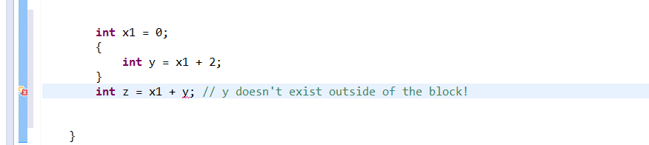
Scope in compound statements
Compound statements are enclosed in braces { }
The compound statement is called a block
The scope of a variable declared in a block is from its declaration to the end of the block.
Variables declared outside of the block are usable both outside and inside.

Slide 29
Announcements
Project 4 due April 3rd, 9PM
Demo project
Lab 8 due March 20th, 9PM
Today: Finish sections 5.1 – 5.3
Read chapter 5. Read it twice.
Google is coming! March 26th 5pm MLC Room 248
Updated Course Calendar
Exam 2: Tuesday, March 31st
Review for Exam 2: Thursday, March 26th
Exam 2 study guide (list of topics) posted now

Slide 30
Parameters (of Primitive Type)
Methods can be defined to accept arguments.
In the method declaration (in the class), these are called formal parameters.
They specify the type and number of inputs to the method.
When a method is invoked, it is invoked with values in the positions for the formal parameters.
The values are called actual parameters (or just arguments).
The values are copied into the formal parameter variables.
This is called “pass-by-value” (the actual value is copied over).
Lets modify getPopulationIn10() to take a parameter.

Slide 31
Parameters (of Primitive Type)
public int sum(int x, int y)
{
int z = x + y;
return z;
}
int w = 10;
int z = 20;
System.out.println(sum(w,z));
Which are the formal parameters? The actual parameters?
When invoked, the values (actual parameters) of w (10) and z (20) are copied to the formal parameters (x) and (y). A value is returned.
Lets draw what this looks like in memory

Slide 32
Parameters (of Primitive Type)
public int swap(int x, int y)
{
int temp = x;
x = y;
y = temp;
}
int w = 10;
int z = 20;
swap(w,z);
System.out.println(w + " " + z);
When invoked, the values of w (10) and z (20) are copied to the formal parameters (x) and (y).
The values of x and y are then swapped.
The values of z and w remain unchanged, however.
This illustrates “pass-by-value” (or call-by-value).

Slide 33
Parameters (of Primitive Type)
What if we use x and y for the actual and formal parameters?
Formal Parameters are local variables (they are local to the method).
public int swap(int x, int y)
{
int temp = x;
x = y;
y = temp;
}
int x = 10;
int y = 20;
swap(x,y);
System.out.println(x + " " + y);

Slide 34
Parameters of Primitive Type
When values of parameters are primitive types (double, int, float, etc.), the method cannot change the value of the actual parameters.
The actual parameter values are copied to the formal parameters (pass-by-value).

Slide 35
Defining an equals Method
== shouldn’t be used (often) to compare two objects
Instead, we should use equals, a method which will make appropriate comparisons as needed.
Equals should return a boolean value.
In the string class, this was provided. In our classes, we write it our selves.
How would you write an equals method for species?

Slide 36
Defining an equals Method
== shouldn’t be used (often) to compare two objects
Instead, we should use equals, a method which will make appropriate comparisons as needed.
Equals should return a boolean value.
In the string class, this was provided. In our classes, we write it our selves.
How would you write an equals method for species?
public class Species
{
private String name;
private int population;
private double growthRate;
…
public boolean equals(Species otherObject)
{
return (name.equalsIgnoreCase(otherObject.name)) &&
(population == otherObject.population) &&
(growthRate == otherObject.growthRate);
}

Slide 37
Information Hiding
What were some of the benefits of OO programming?
Another Benefit: Information hiding: Designing a method so it can be used without knowing it’s internal details.
A programmer using a class method need not know all of the details of implementation.
He/She only needs to know what the method does
Also referred to as abstraction.
Part of information hiding is providing comments at the top of your methods so the user doesn’t have to understand the details of the implementation.

Slide 38
Pre- and Postcondition Comments
We may describe (in comments) the conditions under which a method may be called, and the effects of its invocation.

Slide 39
Pre- and Postcondition Comments
Precondition comment: States conditions that must be true before method is invoked
Postcondition comment: Tells what will be true after method executed

Slide 40
The public and private Modifiers
Making our instance variables (data members) private is one way to ensure the correct use of our class files.
We can control access to class members using access modifiers.
Each class declaration, and each declaration for a method or nonlocal variable can be preceded by an access modifier.
public: any class can directly access that element. Classes are generally declared public
private: a member declared private can only be accessed from within the class in which it is defined. Instance variables should almost always be declared private.
Do rectangle example in eclipse.

Slide 41
/** Class that represents a rectangle.*/
public class Rectangle
{
public int width;
public int height;
public int area;
public void setDimensions(int newWidth, int newHeight)
{
width = newWidth;
height = newHeight;
area = width * height;
}
public int getArea()
{
return area;
}
}
Here, since the instance variables are public, it’s possible for the area to disagree with the width and height. The object has an inconsistent state.

Slide 42
/** Class that represents a rectangle.*/
public class Rectangle
{
private int width;
private int height;
private int area;
public void setDimensions(int newWidth, int newHeight)
{
if(newWidth > 0 && newHeight > 0){
width = newWidth;
height = newHeight;
area = width * height;
}
}
public int getArea()
{
return area;
}
}
Private members allow more control over how they are used.
As written, these instance variables cannot be accessed outside of the class.

Slide 43
Accessor and Mutator Methods
When instance variables are private (and we want others to access to them), we should provide accessor methods to access their values.
These are typically named getName where (Name is the variable name).
We should also provide mutator methods to change the values of the private instance variables.
These are typically named setName.

Slide 44
public class Rectangle2
{
private int width;
private int height;
public void setWidth(int newWidth){
if(newWidth > 0)
width = newWidth;
}
public void setHeight(int newHeight){
if(newHeight > 0)
height = newHeight;
}
public int getWidth(){
return width;
}
public int getHeight(){
return height;
}
public int getArea(){
return width * height;
}
}
The width and height variables are only accessible through the “getter” and “setter” methods.
No setter method is defined for area (it doesn’t make sense to).
The setter methods allow us to check that the input argument is valid (e.g., not negative).

Slide 45
Encapsulation
Private data members also help achieve encapsulation
A well designed program should utilize encapsulation, dividing the program into a public interface and an underlying (private) implementation.
“Interface”: Only those pieces needed by the user are exposed and accessible to the user.
The public methods and constants, and the documentation/comments for them.
The interface minimizes the complexity of the program to the user.
It also makes the program more secure.
The underlying implementation of the program is not known to the user (and access to it is restricted)
Multiple implementations—consistent with the interface— are possible.

Slide 46
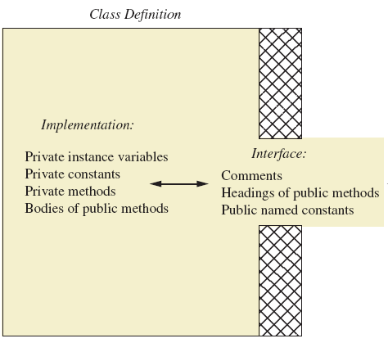
Encapsulation
Programmer who uses the class

Slide 47
Encapsulation: Some Guidelines
Preface class definition with comment on how to use class
Declare all instance variables private.
Provide public “getter” and “setter” methods
Place a comment before each public method heading that fully specifies how to use the method.
Make any helper (auxiliary) methods private.
Methods that the user need not see
Write comments within the class definition to describe implementation details.

Slide 48
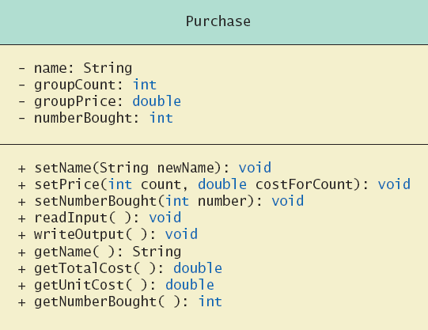
UML Class Diagrams
UML class diagrams are a graphical way of describing the structure of classes, including their interfaces.
The diagram can be viewed as an outline for a class.
Minus signs imply private access
Plus signs imply public access

Slide 49
Methods Calling Methods
Called Method Chaining
One method can make a call to another method.
If the invoked method is within the same class, you need not use an object name.

Slide 50
public class MethodChaining {
public int methodOne() {
System.out.println("Inside Method 1");
System.out.println("Leaving Method 1");
return 1;
}
public int methodTwo() {
System.out.println("Inside Method 2");
int value = methodOne() + 1;
System.out.println("Leaving Method 2");
return value;
}
public int methodThree() {
System.out.println("Inside Method 3");
int value = methodTwo() + 2;
System.out.println("Leaving Method 3");
return value;
}
public static void main(String[] args)
{
MethodChaining mc = new MethodChaining();
int v = mc.methodThree();
System.out.println("Final value is: "+ v);
}
}

Slide 51
public class MethodChaining {
public int methodOne() {
System.out.println("Inside Method 1");
System.out.println("Leaving Method 1");
return 1;
}
public int methodTwo() {
System.out.println("Inside Method 2");
int value = methodOne() + 1;
System.out.println("Leaving Method 2");
return value;
}
public int methodThree() {
System.out.println("Inside Method 3");
int value = methodTwo() + 2;
System.out.println("Leaving Method 3");
return value;
}
public static void main(String[] args)
{
MethodChaining mc = new MethodChaining();
int v = mc.methodThree();
System.out.println("Final value is: "+ v);
}
}
Inside Method 3
Inside Method 2
Inside Method 1
Leaving Method 1
Leaving Method 2
Leaving Method 3
Final value is: 4

Slide 52
Variables of a Class Type
To date, we have mostly dealt with variables of primitive data type.
We have occasionally used class type variables (so-called reference variables).
Note: All class variables correspond to a memory location.
the memory location assigned to a variable of class type contains the memory address of the object named by the variable.
int x = 10; //primitive
String s = "Hi Mom!"; //reference (class type)

Slide 53
Variables of a Class Type
For class type variables, the object (value) itself not stored in the variable.
It is stored elsewhere in memory.
The variable contains the address of where it is stored.
The memory address is called the reference to the object.
A reference type variable holds references (memory addresses).

Slide 54
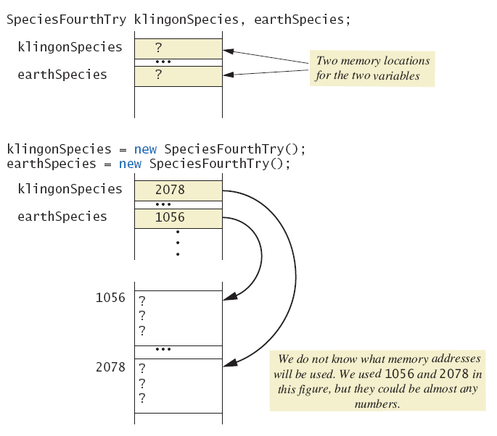
Variables of a Class Type
When reference variables are declared, memory is allocated for them.
However, what is stored in these memory locations are references (addresses) of other memory locations.

Slide 55
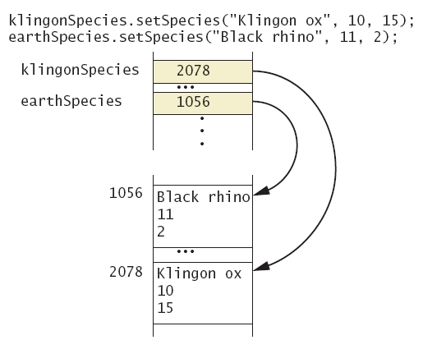
Variables of a Class Type
Assume we have a setSpecies(name, population, growthRate) method in our species class.
This is what two calls to that method would do:
Here, the variables are to two distinct objects in memory.

Slide 56
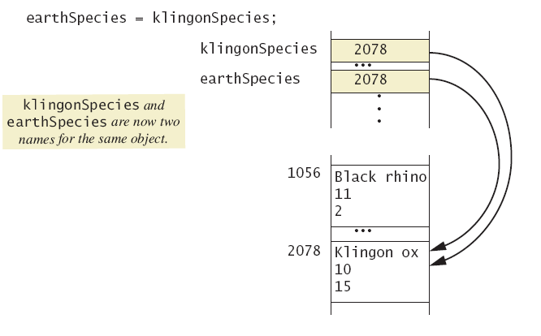
Variables of a Class Type
What if we execute the line:
earthSpecies = klingonSpecies;
The two variables now hold references to the same object.

Slide 57
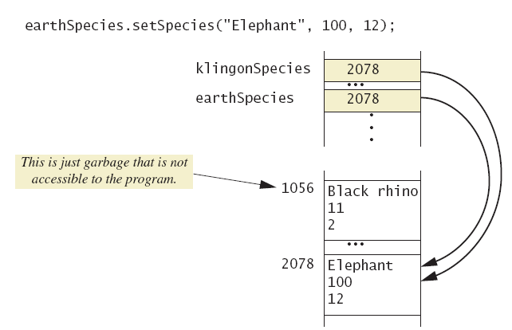
Variables of a Class Type
If we change earthSpecies or klingonSpecies, they will both be changed since they point to the same object!
The object at address 1056 is no longer accessible (and will be reclaimed by the “garbage collector”.

Slide 58
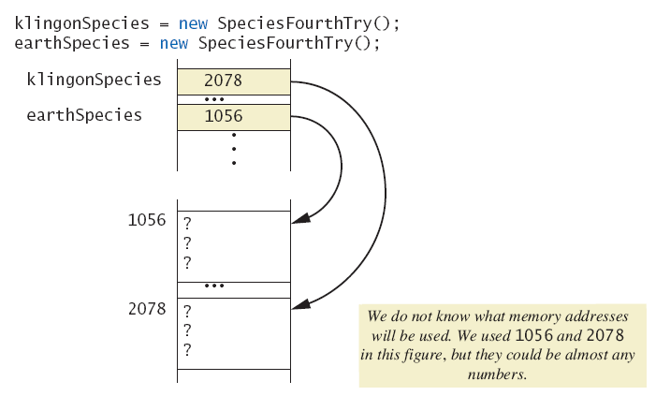
Variables of a Class Type
Two objects might have identical values for all of their attributes and yet be stored in distinct memory locations.
As with Strings, == is used to determine whether two objects are stored in the same location.
A == B is true if the memory addresses for A and B are the same.

Slide 59
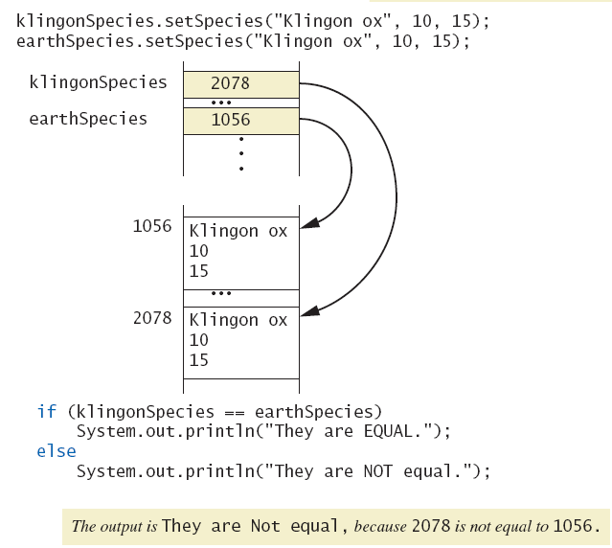
Variables of a Class Type

Slide 60
Defining an equals Method
== shouldn’t be used (often) to compare two objects
Instead, we should use equals, a method which will make appropriate comparisons as needed.
Equals should return a boolean value.
In the string class, this was provided. In our classes, we write it our selves.
How would you write an equals method for species?
public class Species
{
private String name;
private int population;
private double growthRate;
…
public boolean equals(Species otherObject)
{
return (name.equalsIgnoreCase(otherObject.name)) &&
(population == otherObject.population) &&
(growthRate == otherObject.growthRate);
}

Slide 61
public class SpeciesEqualsDemo
{
public static void main(String[] args)
{
Species s1 = new Species( ), s2 = new Species( );
s1.setSpecies("Klingon ox", 10, 15);
s2.setSpecies("Klingon ox", 10, 15);
if (s1 == s2)
System.out.println("Match with ==.");
else
System.out.println("Do Not match with ==.");
if (s1.equals(s2))
System.out.println("Match with the method equals.");
else
System.out.println("Do Not match with the method equals.");
System.out.println("Now change one Klingon ox to lowercase.");
s2.setSpecies("klingon ox", 10, 15); //Use lowercase
if (s1.equals(s2))
System.out.println("Match with the method equals.");
else
System.out.println("Do Not match with the method equals.");
}
}

Slide 62
Unit Testing
As programs become bigger in size, testing becomes more difficult.
We can’t test it all at once.
One methodology that has been developed is to test the correctness of individual “units” of code.
Units are typically methods, but they could be classes or bigger units.
A collection of unit tests is a test suite.
The testing is usually automated.
Typically, the tests are stored in a separate class/file.

Slide 63
public class SpeciesTest{
public static void main(String[] args){
Species testSpecies = new Species();
// Test the setSpecies method
testSpecies.setSpecies("Tribbles", 100, 50);
if (testSpecies.getName().equals("Tribbles") &&
(testSpecies.getPopulation() == 100) &&
(testSpecies.getGrowthRate() >= 49.99) &&
(testSpecies.getGrowthRate() <= 50.01)){
System.out.println("Pass: setSpecies test.");
}
else{
System.out.println("FAIL: setSpecies test.");
}
// Test the predictPopulation method
if ((testSpecies.predictPopulation(-1) == 100) &&
(testSpecies.predictPopulation(1) == 150) &&
(testSpecies.predictPopulation(5) == 759))
{
System.out.println("Pass: predictPopulation test.");
}
else{
System.out.println("FAIL: predictPopulation test.");
}
}
}

Slide 64
Parameters of a Class Type
(This is important)
When ‘=’ is used with objects (e.g., obj1 = obj2), only the memory address (the reference) is copied.
The same thing happens with objects used as actual parameters (arguments) to methods.
When an object is used as an actual parameter, its memory address is copied to the formal parameter.
The method thus can manipulate the public elements of the object (using the reference stored in the formal parameter).

Slide 65
Programming Example
SwapDemo
class DemoSpecies (pg. 342)
class ParametersDemo (pg. 344)

